Slide 1
Testing Strategies – Condensed Version
David M. Rogers (he/him) Oak Ridge National Laboratory
Better Scientific Software tutorial @ Improving Scientific Software conference (2023)
Contributors: David E. Bernholdt (ORNL), Anshu Dubey (ANL), Rinku Gupta (ANL), Mark C. Miller (LLNL), David M. Rogers (ORNL)
Notes:
So, your software's current functionality has been documented, and some initial tests are written. Where do you go from here? How do you improve your testing situation to the point where it's considered "done"?

Slide 2

License, Citation and Acknowledgements
License and Citation
This work is licensed under a Creative Commons Attribution 4.0 International License (CC BY 4.0).
The requested citation the overall tutorial is: David E. Bernholdt, Patricia A. Grubel, and David M. Rogers, Better Scientific Software tutorial, in Improving Scientific Software, Boulder, Colorado and online, 2023. DOI: 10.6084/m9.figshare.22179748.
Individual modules may be cited as Speaker, Module Title, in Tutorial Title, …
Acknowledgements
This work was supported by the U.S. Department of Energy Office of Science, Office of Advanced Scientific Computing Research (ASCR), and by the Exascale Computing Project (17-SC-20-SC), a collaborative effort of the U.S. Department of Energy Office of Science and the National Nuclear Security Administration.
This work was performed in part at the Argonne National Laboratory, which is managed by UChicago Argonne, LLC for the U.S. Department of Energy under Contract No. DE-AC02-06CH11357.
This work was performed in part at the Lawrence Livermore National Laboratory, which is managed by Lawrence Livermore National Security, LLC for the U.S. Department of Energy under Contract No. DE-AC52-07NA27344.
This work was performed in part at the Los Alamos National Laboratory, which is managed by Triad National Security, LLC for the U.S. Department of Energy under Contract No.89233218CNA000001
This work was performed in part at the Oak Ridge National Laboratory, which is managed by UT-Battelle, LLC for the U.S. Department of Energy under Contract No. DE-AC05-00OR22725.
This work was performed in part at Sandia National Laboratories. Sandia National Laboratories is a multi-mission laboratory managed and operated by National Technology and Engineering Solutions of Sandia, LLC., a wholly owned subsidiary of Honeywell International, Inc., for the U.S. Department of Energy’s National Nuclear Security Administration under contract DE-NA0003525.

Slide 3
Hypothetical
Matthew Norman and Jeffrey Larkin. A Holistic Algorithmic Approach to Improving Accuracy, Robustness, and Computational Efficiency for Atmospheric Dynamics. SIAM J. SCI. COMPUT. Vol. 42, No. 5, pp. B1302-B1327 (2020). DOI:10.1137/19M128435X
We want to test out a new time-integration method for our atmospheric transport equations. It's still finite-volume, but uses a different way to limit oscillations.
How does it perform on 1D transport?
It looks like it preserves discontinuity shapes better. We'd like to achieve higher accuracy at lower time-to solution. How can we test that?
We'll need to compare the old and new integration outputs, and change the grid resolutions. We'll need some timings too.

Slide 4
What is Testing
Whenever you write a code you are doing it
When you compile it, you are testing for defects in syntax
When you run it for the first time you are testing for correctness
When you add any code and run it again, you are testing it again
When you break down your development into smaller chunks you test each chunk, then you combine the chunks, and you test again.

Slide 5
What is Testing
Whenever you write a code you are doing it
When you compile it, you are testing for defects in syntax
When you run it for the first time you are testing for correctness
When you add any code and run it again, you are testing it again
When you break down your development into smaller chunks you test each chunk, then you combine the chunks, and you test again.
Testing is an integral part of code development
Notes:
Address perception of testing as an obstacle to progress: Formalization of the testing process and adding infrastructure makes it easier (after overcoming initial adoption barrier).

Slide 6
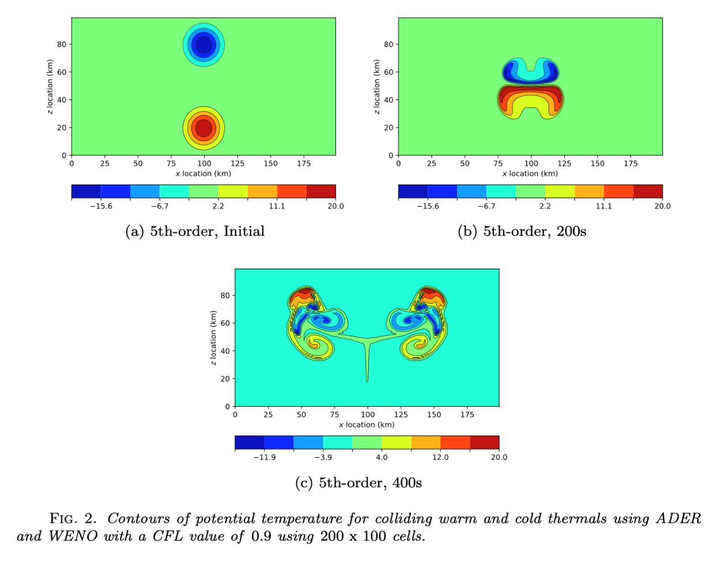
Hypothetical
Matthew Norman and Jeffrey Larkin. A Holistic Algorithmic Approach to Improving Accuracy, Robustness, and Computational Efficiency for Atmospheric Dynamics. SIAM J. SCI. COMPUT. Vol. 42, No. 5, pp. B1302-B1327 (2020). DOI:10.1137/19M128435X
Here's a 2D result from the new integrator method.
Great, let's get the rest of the code switched over.
This will be faster and safer if we have the right tests in-place.

Slide 7
Test/Doc Driven Development
Documented specifications and requirements of the code
Ensures that thought is given to what it means for the program to be correct, rather than just what the program should do
More efficient development cycle
Much less debugging
Requires:
Care in writing tests
Frequent running of tests
Wide adoption by development team
Consider new code
Test and modify code
Write/
modify tests
Implement/modify code

Slide 8
How to build your test suite?
Two “levels”
Automated / scheduled testing
May be long running
Provide comprehensive coverage
Continuous integration
Quick diagnosis of error
A mix of different granularities works well
Unit tests for isolating component or sub-component level faults
Integration tests with simple to complex configuration and system level
Restart tests
Rules of thumb
Simple
Enable quick pin-pointing
Useful resources https://ideas-productivity.org/resources/howtos/
Notes:
Let's think about this problem as "selecting the right tests." Taking a step back, there are two 'levels' of tests (regression testing and CI-type tests), and there are multiple 'granularities' of tests (from unit to integration). Computer scientists tend to gravitate towards tests that run quickly and check data structures, types, definitions, syntax, and error reporting. These quick tests are great for a continuous integration suite. Domain scientists tend to think of ways to compare program outputs to external measures - like known solutions and example run cases. These tests can be long-running, and need interpretation to understand what's going on. Such tests are often better suited for scheduled testing - which can be set up to run on dedicated servers on a nightly or weekly schedule. And there is a range of intermediate levels of testing pertaining to interoperability in component-based software systems, verification of non-trivial functionality such as transparent restart from a checkpoint etc. Since testing is so broad, individual tests can also vary in complexity. As a rule of thumb, complicated tests get -100 points. Tests should be as simple as possible, and always provide information on what went wrong. If a test can't help to diagnose an error condition, it's not a useful test.

Slide 9
Types of Tests
Additional types of tests needed for research software
Composite unit tests – are tests for specific functionalities and/or capabilities
Granular tests – are integration tests at various granularities verifying correct behavior of interoperating functional units
Restart tests – verify that a run can restart transparently from a checkpointed state
Performance tests – apply to high-performance computing codes, verify that there is no performance loss

Slide 10
Types of Tests
Well known tests for enterprise software
Unit tests – verify a single function, extremely quick to run
Regression tests – verify that there is no degradation in code capabilities
Integration tests – verify functions working together
System tests – verify functionality of the entire software
Acceptance tests – verify that the client needs are met

Slide 11
Classes of Tests
Open box testing – when you know the internals and can modify the code you are testing
Likely to be the code you and your collaborators are developing
You can insert assertions
You can insert code snippets that make testing easier
Closed box testing – when you do not know the internals of the code being tested, and cannot modify the code
Third party software or legacy code
The only means of verification available is reasoning about output to be obtained from supplied input

Slide 12
Hypothetical
Matthew Norman and Jeffrey Larkin. A Holistic Algorithmic Approach to Improving Accuracy, Robustness, and Computational Efficiency for Atmospheric Dynamics. SIAM J. SCI. COMPUT. Vol. 42, No. 5, pp. B1302-B1327 (2020). DOI:10.1137/19M128435X
Test Runners
External (consumer) package
downstreams
Test Case 2
Test Case 1
time integrator
Input routines
meshing
state representation
forcing equations
Output routines
Network Libraries
Mathematical Libraries
upstreams
A partially transformed code state

Slide 13
Additional Notes: Good Testing Practices
Verify Code coverage
Must have consistent policy on dealing with failed tests
Issue tracking
How quickly does it need to be fixed?
Who is responsible for fixing it?
Someone should be watching the test suite
When refactoring or adding new features, run a regression suite before check in
Add new regression tests or modify existing ones for the new features
Code review before releasing test suite is useful
Another person may spot issues you didn’t
Incredibly cost-effective
Notes:
OK - now everyone is onboard with your testing plan, and your code is in a good place. What happens next? You can double-check your work using a code coverage tool. You can create a policy on what to do with failed tests and issues marked as "bugs." It helps to assign responsibility for the test suite - both so that things happen, and also so that you can recognize the hard work put in by that team member. You should consider your test suite during refactorings, and use it for the code release process. Cost-effectiveness comes in here because, if you already have defined functionalities and tests, then it's much less likely that your team will get side-tracked by maintaining fixes and patches for past releases. That is a rabbit-hole nobody wants to go down.

Slide 14
Mixed Open/Closed Box Testing For a Legacy Code
There may not be existing tests
Isolate a small area of the code
Dump a useful state snapshot
Build a test driver
Start with only the files in the area
Link in dependencies
Copy if any customizations needed
Read in the state snapshot
Restart from the saved state
Verify correctness
Always inject errors to verify that the test is working
state
driver
Notes:
Here's an example from the E3SM code, the Exascale Earth System Model. Although advanced now, it originated in a combination of Fortran codes dealing with various aspects of climate modeling. The project came together from a collection of independent projects and development practices. They imposed structure on the code through the use of Fortran modules. However, the focus was on running whole models, so their architecture and testing strategies evolved to work with that goal. That led to an unforeseen difficulty. For several sections of the code, even the simplest modification would take running the entire model to test. This meant enqueuing the job in a batch queue that would take non-trivial amount of time to run. What was missing was granular testing. And it wasn’t easy to separate out code sections for testing independently because one Fortran module gets data from another, that in turn gets data from yet another and so on … This is an example of a methodology used to generate an independent test for a code section.
Review the dependencies. Here the model needs to be at a certain ”state” to invoke the target code.
Look for dependencies on Fortran data modules that are outside the sub-tree containing the source code for this section
For each of the data modules determine where the dependencies can be pruned.
d) Run the full model and capture the “state” just before the invocation of the target section.
e) Create a separate working directory for the test
f) In this working area create soft links to the files that have dependencies
g) Where the dependence is to be pruned create a copy of the corresponding file in the working area and modify it as needed.
e) Create a test driver to load the state and exercise the unit.
d) If extra functions from the code were accessed, these were sym-linked into the test directory. Here, the branch at the right represents some helper functions that can be imported easily.
e) That doesn't always work. The red dot represents a module with lots of dependencies - not needed for this test. In these cases, the module was modified to remove unnecessary dependencies.
f) With all the code dependencies sorted out, the test driver itself becomes an isolated unit. For this example, the original test took hours to run through the batch queue of a cluster. The new unit test ran in 20 seconds on a developer's laptop.

Slide 15
How to build your test suite?
A mix of different granularities works well
Unit tests for isolating component or sub-component level faults
Integration tests with simple to complex configuration and system level
Restart tests
Does this test add value?
Simple
Enable quick pin-pointing
Notes:
Let's think about this problem as "selecting the right tests." Taking a step back, there are two 'levels' of tests (regression testing and CI-type tests), and there are multiple 'granularities' of tests (from unit to integration). Computer scientists tend to gravitate towards tests that run quickly and check data structures, types, definitions, syntax, and error reporting. These quick tests are great for a continuous integration suite. Domain scientists tend to think of ways to compare program outputs to external measures - like known solutions and example run cases. These tests can be long-running, and need interpretation to understand what's going on. Such tests are often better suited for scheduled testing - which can be set up to run on dedicated servers on a nightly or weekly schedule. And there is a range of intermediate levels of testing pertaining to interoperability in component-based software systems, verification of non-trivial functionality such as transparent restart from a checkpoint etc. Since testing is so broad, individual tests can also vary in complexity. As a rule of thumb, complicated tests get -100 points. Tests should be as simple as possible, and always provide information on what went wrong. If a test can't help to diagnose an error condition, it's not a useful test.

Slide 16
How do we determine what tests are needed?
Code coverage tools
Expose parts of the code that aren’t being tested
gcov - standard utility with the GNU compiler collection suite (we will use it in the next few slides)
Compile/link with –coverage & turn off optimization
Counts the number of times each statement is executed
Necessary for testing, but not sufficient
gcov also works for C and Fortran
Other tools exist for other languages
JCov for Java
Coverage.py for python
Devel::Cover for perl
profile for MATLAB
Lcov
a graphical front-end for gcov
available at http://ltp.sourceforge.net/coverage/lcov.php
Codecov.io in CI module
Hosted servers (e.g., coveralls, codecov)
graphical visualization of results
push results to server through continuous integration server
Notes:
Even if you follow the TDD methodology, it is useful to know how much code is actually being tested.

Slide 17
Building Test-suite
First line of defense – code coverage tools
Code coverage tools necessary but not sufficient
Do not give any information about interoperability
Map your tests and examples – what do they do?
Follow the order
All unit tests – including full module tests (e.g., CL)
Tests sensitive to perturbations (e.g., SV)
Most stringent tests for solvers (e.g., WD, PT)
Least complex test to cover remaining spots (Aha!)
Notes:
This final example shows a graphical way to "map" areas of your code for testing. The x-axis has physical capabiliies. The y-axis has infrastructure and generic solvers. List out all test and mark the corresponding squares in the matrix if the two corresponding features are exercised together in the test. For example here SV stands for the Sedov test run with Uniform grid and includes tracer particles. Similarly the celluar test (CL) runs with AMR and also includes nuclear burning and particles in addition to Hydro and EOS. The idea is to know which of these squares need to be marked to have sufficient amount of interoperability coverage needed by the code. Not every square needs to be covered, though. It also helps document areas of your code that are needed for each science scenario.
This type of map is complementary to code coverage. If your program is well-structured, there should be some correspondence between this map and the files that coverage shows as "tested".
The Order described here gives guidelines for how to select the tests to maximize the needed coverage while minimizing the cost. It is always desirable to run the fastest and most lightweight tests that can pinpoint the error.

Slide 18
Good Rules of Thumb
Test your tests!
Make sure tests fail when they’re supposed to!
Add “regression tests”
Ensure that old bugs aren’t reappearing
Test regularly
Critical when teams are adding code regularly
To identify and document where changes to the underlying platform change code behavior/results
Automate regular testing
Inculcate the discipline of monitoring the outcome of regular testing
Test your assumptions
Exercise third-party dependencies, prove they work for your case
Add tests when joining a new code
Stash tests used to diagnose issues
Physics/math-based strategies
Conserved quantities, symmetries, synthetic operators
Use "specs" to eliminate dependence on bitwise reproducibility
Notes:
Slides from reproducibility talk

Slide 19
Testing Takeaways
A testing strategy is essential for producing reliable trustworthy software
Invest the time needed to thoroughly test your software at all levels
Use automation whenever possible
Different challenges are associated with exploratory, legacy, and composable codes
Adapt your strategy to fit your situation.
Eventually you will want to be able to verify all components in a code release.
Don’t get distracted by all the technologies out there – focus on exercising your code.
Scaffolding projects can help with mechanics.

Slide 20
Questions?
Testing Types
scheduled vs. continuous
unit vs. module vs. integration
restart, performance, regression
system and acceptance testing
Testing Classes
open/closed box: ability to modify codebase
inferring vs. checking behavior (bottom-up vs. top-down)
Testing Practices
coverage, resolution policies, release checklists
Testing areas
proving: assumptions, invariants, external behavior, interfaces, types and specifications
Definition of Done
coverage and test matrices
level of confidence vs. concept / code maturity

Slide 21

What is Continuous Integration (CI)?
https://docs.gitlab.com/ee/ci/introduction/
Notes:
Go over the definitions and how it is used in a workflow. A process of inserting a check in development cycle.

Slide 22
CI Components
Testing
Focused, critical functionality (infrastructure), independent, orthogonal, complete, …
Existing test suites often require re-design/refactoring for CI
Integration
Changes across key branches merged & tested to ensure the “whole” still works
Integration can take place at multiple levels
Individual project
Spack
E4S
Develop, develop, develop, merge, merge, merge, test, test, test…NO!
Develop, test, merge, develop, test, merge, develop, test, merge…YES!
Continuous
Changes tested every commit and/or pull-request (like auto-correct)
CI generally implies a lot of automation

Slide 23

Examples…
Automated Nightly Testing Dashboard Lives “next to” your development work
CI Testing Lives embedded in your development work

Slide 24
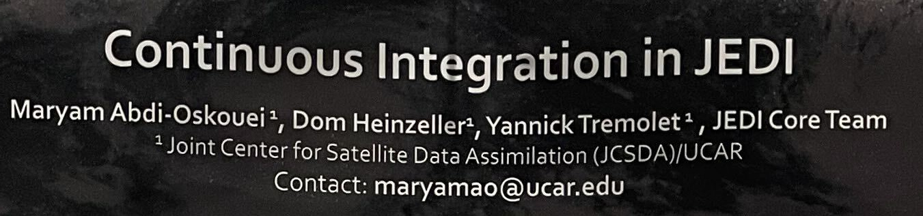
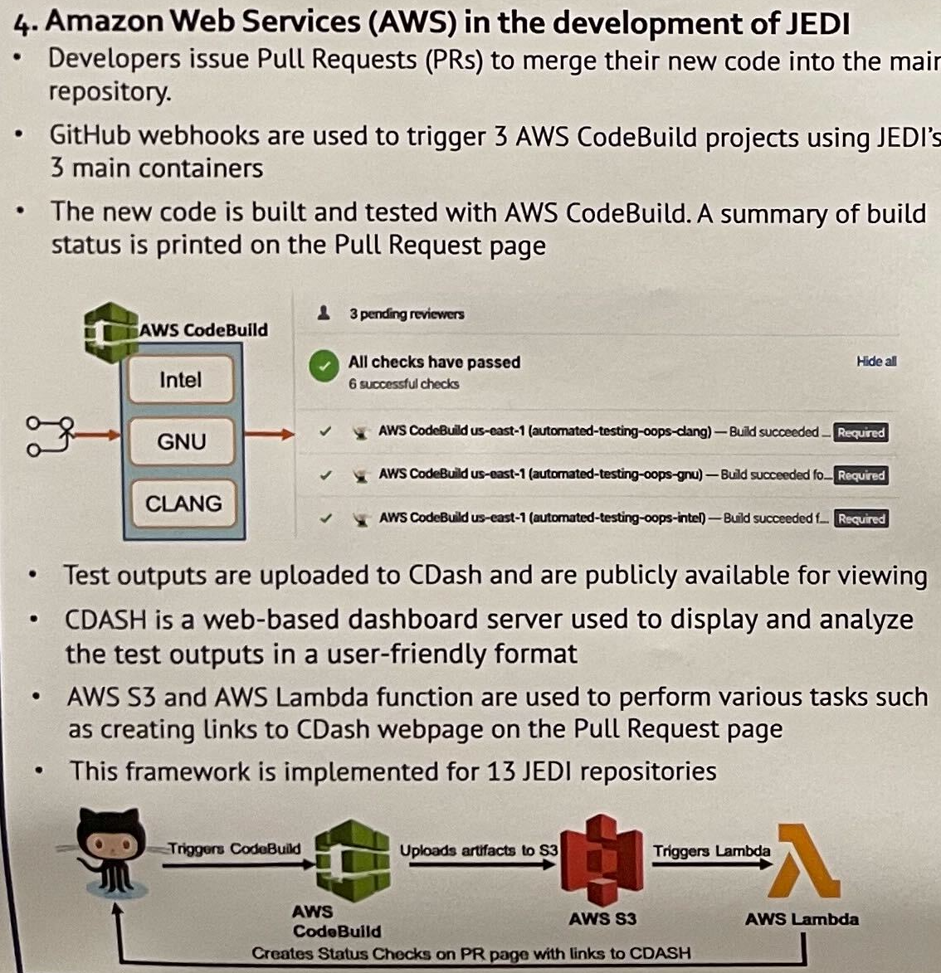
Examples... Joint Center for Satellite Data Assimilation (JEDI)
Posted to slack/spack#appreciation from the AGU Fall Meeting, Chicago by Evan Bollig
The JEDI Singularity and CharlieCloud containers are better supported and provide a more familiar working environment for most users and developers. The recommended practice is therefore to first establish a linux environment on your laptop or PC using a virtual machine provider like Vagrant and then to run the JEDI Singularity or Charliecloud container there.
See "Inside JEDI" section for lots of useful recommendations.
https://jointcenterforsatellitedataassimilation-jedi-docs.readthedocs-hosted.com/
Notes:
The Joint Center for Satellite Data Assimilation has large, regular data processing needs. They also have several different software packages that do this processing – so were able to spend some time designing a re-usable build and test pipeline. Their result is worth taking a look at if you interested in containerization.

Slide 25
Hints from the front lines
github.com/CompFUSE/DCA – be nice to contributors (who create forks)
jobs:
sulfur-cpu:
if: |
github.repository_owner == 'CompFUSE' &&
github.event.issue.pull_request &&
startsWith(github.event.comment.body, 'Test this please')
Build inside a container:
Help with step 1:
https://docs.docker.com/build/ci/
Build inside a container locally
Publish your container to docker
Reference from a job, e.g.
"container: node:14.16"
$ spack containerize > Dockerfile
https://spack.readthedocs.io/en/latest/containers.html
https://supercontainers.github.io/sc20-tutorial/07.spack/index.html
https://docs.github.com/en/actions/using-jobs/running-jobs-in-a-container
Notes:
Here's a nice way to use conditions and variables in your CI file to minimize annoyance to people who create forks of your project.
Below are some (unrelated) guidelines on how to run steps of your CI jobs inside containers. This is useful for avoiding compilation of your dependencies.
Caveat – sometimes upstreams change, and it's good to re-compile them so you find out.

Slide 26
Words of warning from github
Warning: When creating workflows and actions, you should always consider whether your code might execute untrusted input from possible attackers. Certain contexts should be treated as untrusted input, as an attacker could insert their own malicious content. For more information, see "Understanding the risk of script injections."
(github)

Slide 27
Hints from the front lines
github.com/ECP-WarpX/WarpX – combine shell patterns in a function
curl -L -o /usr/local/bin/cmake-easyinstall https://git.io/JvLxY
chmod a+x /usr/local/bin/cmake-easyinstall
cmake-easyinstall --prefix=/usr/local \
git+https://github.com/openPMD/openPMD-api.git@0.14.3 \
-DCMAKE_...
...
Cristian Adam, 2020:
https://cristianadam.eu/20200113/speeding-up-c-plus-plus-github-actions-using-ccache/
- name: ccache cache files
uses: actions/cache@v1.1.0
path: $HOME/.ccache
- name: build source
run: |
sudo apt install -y ccache
ccache --set-config=max_size=10.0G [WarpX]
cmake ... -DCMAKE_CXX_COMPILER_LAUNCHER=ccache
Notes:
WarpX uses ccache to speed up its builds. What I found interesting in the code, though, was how the developers published a utility function with git.io. This one does a git clone followed by a cmake build – reducing code spaghetti.
The next hint shows the key ideas to make ccache work. First, install and configure your environment for ccache to work. Next, tell cmake to use ccache as the "compiler launcher". Finally, tell github to cache the contents of the ".ccache".

Slide 28
Hints from the front lines
Configure in Settings / Github Pages
https://docs.gitlab.com/ee/user/project/pages/
https://tomasfarias.dev/posts/sphinx-docs-with-poetry-and-github-pages/
jobs:
build-docs:
steps:
...
- name: Build documentation
run: |
mkdir gh-pages
touch gh-pages/.nojekyll
cd docs/
poetry run sphinx-build -b html . _build
cp -r _build/* ../gh-pages/
- name: Deploy documentation
if: ${{ github.event_name == 'push' }}
uses: JamesIves/github-pages-deploy-action@4.1.4
with: { branch: gh-pages folder: gh-pages }
Notes:
This last hint shows steps to build and deploy sphinx documentation to a github page. Usually, this action is run when there is a push to the main branch, or manually.

Slide 29
Good ideas and idioms from across developer spaces
Golang interfaces
C++ object implementation "rule of 3"
https://en.cppreference.com/w/cpp/language/rule_of_three
Python, pytest
use assertions and automate calling tests
C++, googletest / catch2
write your tests in a uniform way
Javascript, https://jestjs.io/
use a well-featured test package – error reporting, parallel, cached, etc.
Ruby, rails, https://guides.rubyonrails.org/testing.html
define common verbs/types of questions

Slide 30
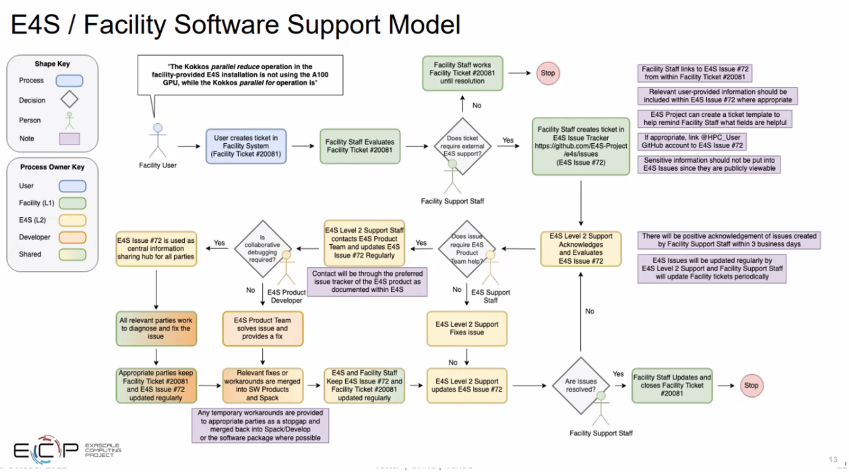
Notes:
Software development has become a collaborative process. Issues drive this process forward. Responsibility is a shared concept that goes between code owners, project groups, HPC facility managers, and users.

Slide 31
The case for software productivity
In software-driven research, scientific productivity is strongly coupled to software productivity. Hence, the scientific output of a research group can be held by challenges such as new computer architectures, advanced algorithms or changing teams of developers. To prevent this productivity collapse, software development needs to be sustainable and scalable by producing comprehensible, maintainable, and extensible code. At the same time, it is essential to release changes ... rapidly to the users, an ability that usually falls under the term continuous delivery. Last but not least, the scientific standard demands correctness, credibility and reproducibility of numerical results in published work. To fulfill these requirements in a challenging environment formed by complex algorithms, performance sensitive codes, the diversity of architectures, and the multidisciplinary of teams, the DCA++ project employs well-proven tools and successful techniques of the software industry [16]. While adopting these methods can require an effort, we believe that [these methods] represent a substantial factor for a research code to become a long-lived software project.
DCA++,Hähner, Alvarez, Maier, Solcà, Staar, Summers, Schulthess, Comput. Phys. Commun. 246, 106709 (2020). DOI:10.1016/j.cpc.2019.01.006
Notes:
Now we get to highlight some work from the scientific software development community. This paragraph in the Dynamic Cluster Approximation ++ package paper explains how software and scientific productivity come as a pair.

Slide 32
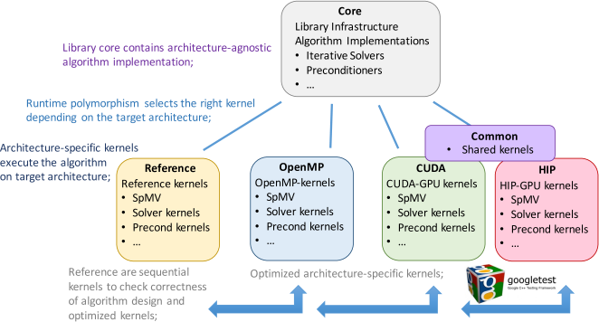
The case for software design
Aside from Ginkgo being used as a framework for algorithmic research, its primary intention is to provide a numerical software ecosystem designed for easy adoption by the scientific computing community. This requires sophisticated design guidelines and high quality code.
Ginkgo, Anzt, Cojean, Flegar, Göbl, Grützmcher, Nayak, Ribizel, Tsai, Quintana-Ortí, ACM Trans. Math. Software 48, 1-33 (2022). DOI:10.1145/3480935
Notes:
The Ginkgo team made a case for strong software design in this paper. Because it was intended to be adopted by applications, the design needed to follow the kind of modular logic that application developers naturally use.

Slide 33

Warp-X
PI: Jean-Luc Vay (LBNL) – DoE Exascale Computing Project (ECP)
A. Almgren, L. D. Amorim, J. Bell, L. Fedeli, L. Ge, K. Gott, D. P. Grote, A. Huebl, R. Jambunathan, R. Lehe, A. Myers,
M. Rowan, O. Shapoval, M. Thévenet, J.-L. Vay, H. Vincenti, E. Yang, N. Zaïm, W. Zhang, Y. Zhao, E. Zoni
Developer Training, Maxence Thévenet (LBNL) - 03/05/2020
WarpX/Regression/
WarpX-tests.ini
WarpX/Examples/
Input files
Analysis script
prepare_file_travis.py
* reformat
Nightly builds on CRD clusters Battra (CPU) and Garuda (GPU)
Every night
See https://github.com/ECP-WarpX/regression_testing
Compare with ref to machine precision
Published at https://ccse.lbl.gov/pub/RegressionTesting/WarpX/
* Catch everything (and more)
TravisCI tests on every commit on GitHub
Every time you push on a branch with open PR
GitHub tells you when they fail
Jobs are submitted by batch (see .travis.yml)
Only tests compilation, run and analysis!!
* Only catch what we ask for
https://warpx.readthedocs.io/
Notes:
Warp-X's testing setup was explained by its developers here. In 2020, they had adopted nightly and CI builds.
Links to docs on use
Re-use of examples as tests
Pro/cons of nightly vs. CI

Slide 34
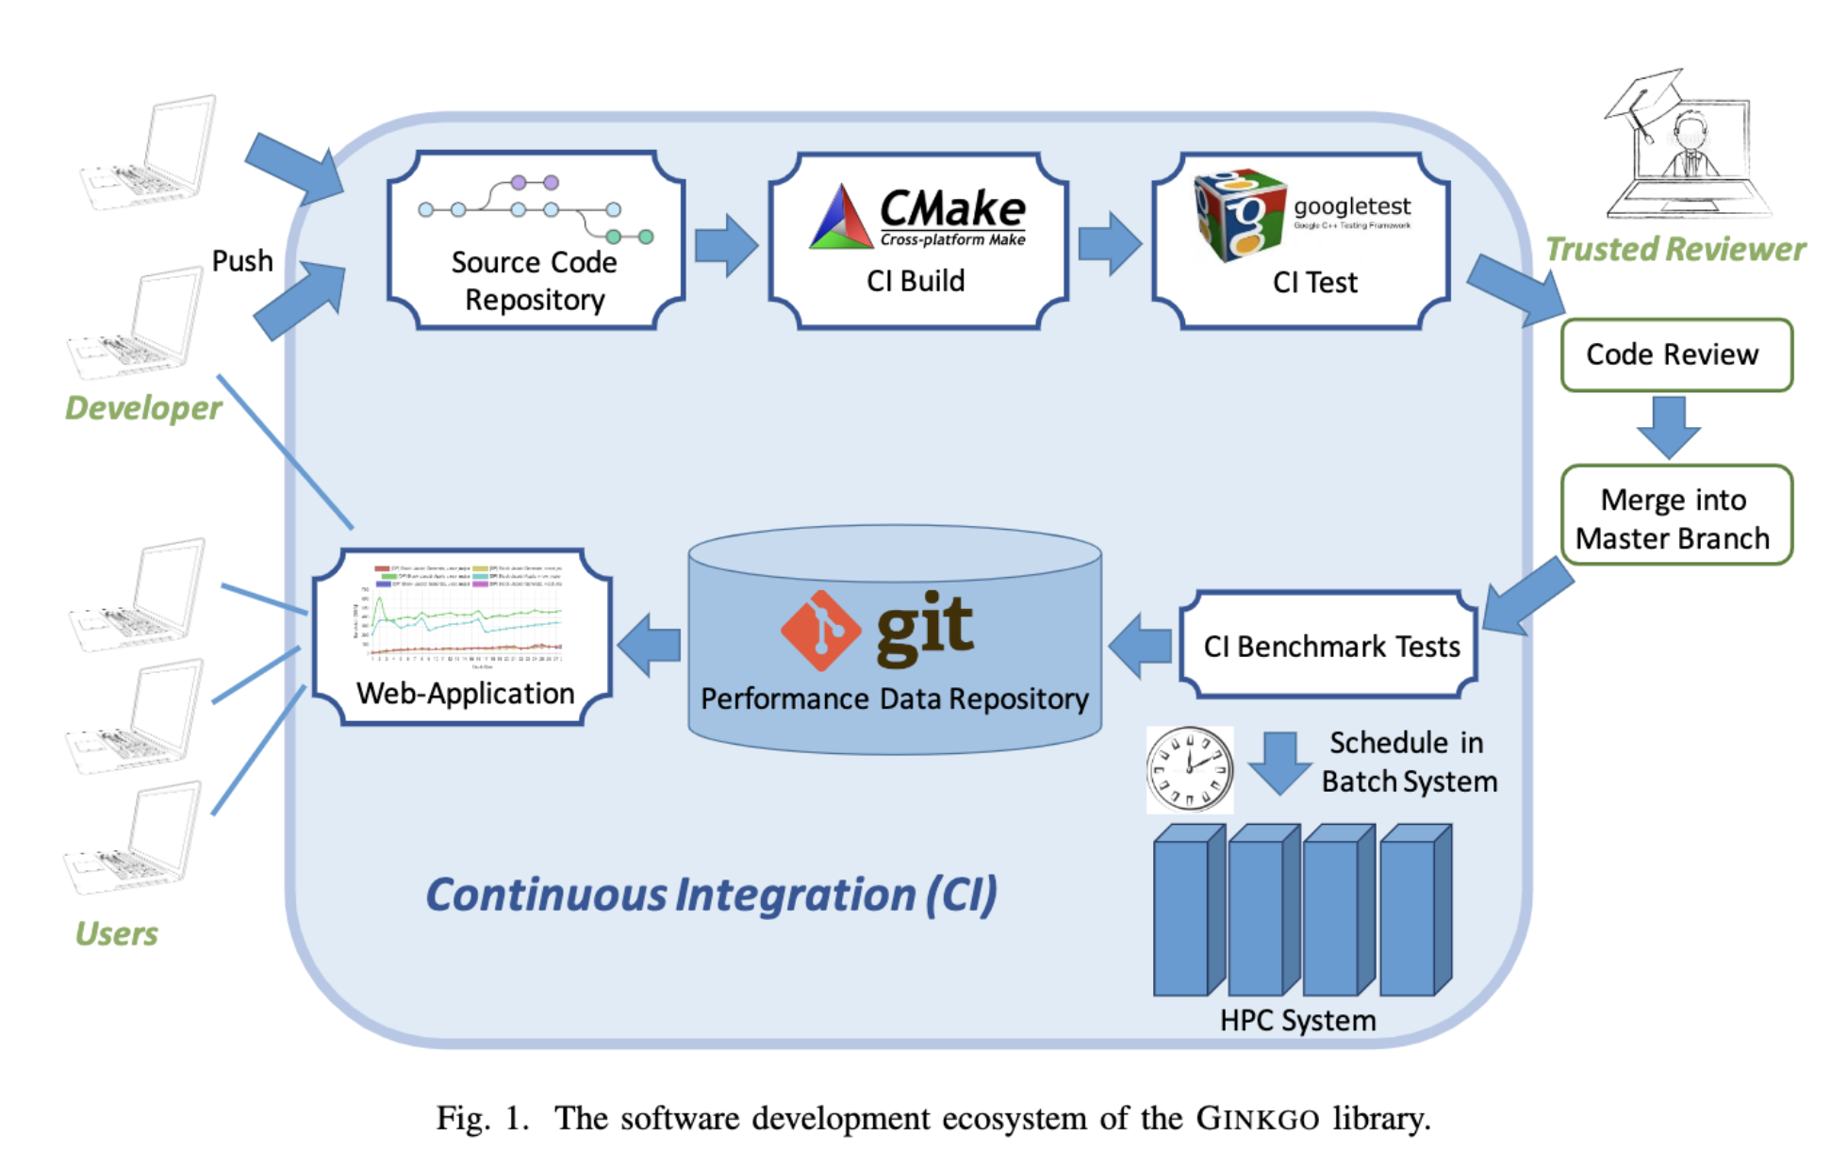

Ginkgo Contribution Pipeline
memory leaks, threading issues, detection of bugs thanks to static code analyzers, etc.
a comprehensive list of unit tests
An Automated Performance Evaluation Framework for the GINKGO Software Ecosystem Anzt, Cojean, Flegar, Grützmacher, Nayak, Ribizel, 90th Int'l Meeting of Int'l Assoc. Appl. Math. And Mech. (2019).
Notes:
Ginkgo also published this paper on how it automated performance evaluation. The CI pipeline, with some particular tool choices is illustrated above.
Unique here, the CI and scheduled tests run a script to output their result to a repository, which has a nice attached web viewer.
Variables stored as "secret tokens" are used so that the script does not compromise the server.

Slide 35
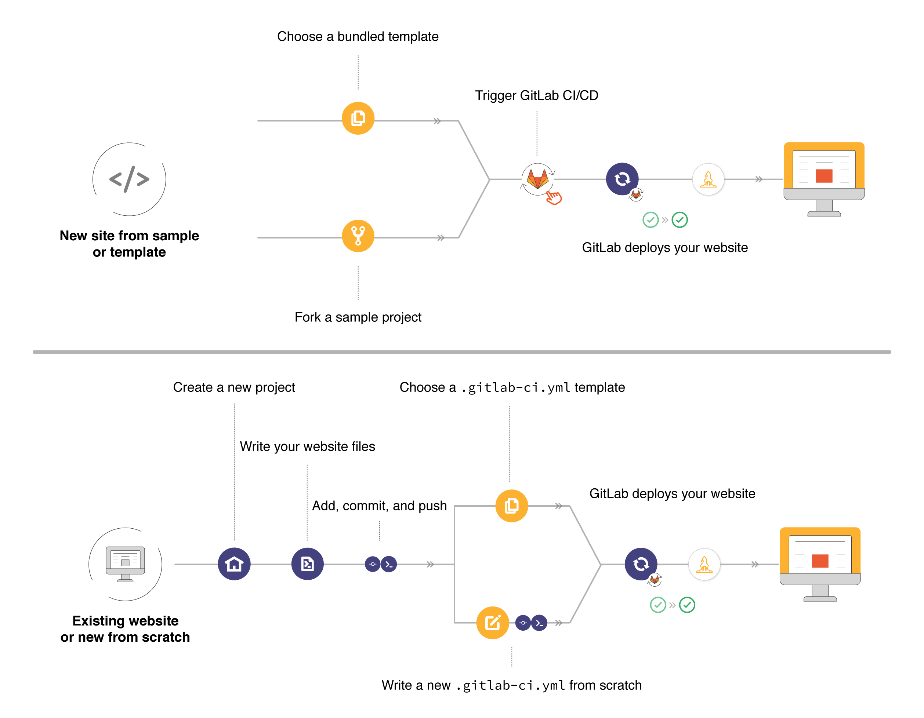
Hints from the front lines
https://code.ornl.gov/8nt/namd-caar-reproducer
https://docs.gitlab.com/ee/user/project/pages/
# This deploys the documentation.
pages:
stage: deploy
cache: # inherit settings
<<: *global_cache
policy: pull
artifacts:
paths:
- public
before_script:
- *enable-venv
script :
- echo "Deploying documentation ..."
- $NCP_TOP_LEVEL/bin/build_documentation.sh --publish-mode gitlab-pages --doc-top-level ${NCP_TOP_LEVEL}/documentation

Slide 36

Team Experiences with CI
Commonalities:
comparing with “golden results” from full-program run
unique mindset needed to develop and maintain unit tests
"adding armor".
Most cited benefits:
identifying potential bugs early,
increasing the project’s ability to receive contributions
Most cited drawbacks:
Effort maintaining tests
trial-and-error running tools
long-running tests are annoying
infrequent random failures (due to network, and other sources)
Implementation didn't disrupt process
After initial adoption hurdle, teams start to insist on it
https://bssw.io/blog_posts/bright-spots-team-experiences-implementing-continuous-integration
Notes:
I'll conclude with some thoughts collected from the ZFP, ExaSMR, and Visit teams on their CI pipelines.

